Slide 1
IN LOVING MEMORY
OF
MARY LOUISE WISE

Slide 2
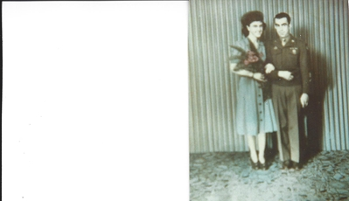

Slide 3
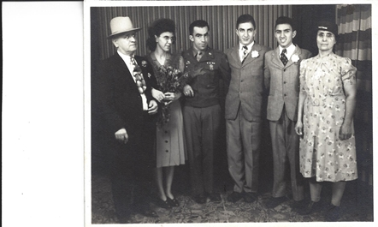

Slide 4
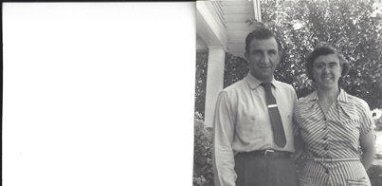

Slide 5
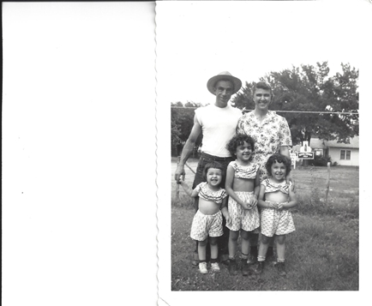

Slide 6
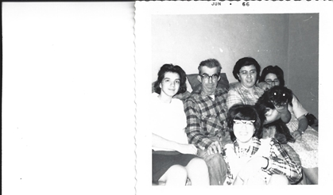

Slide 7
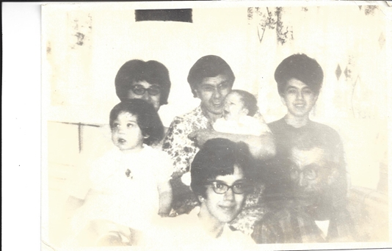

Slide 8
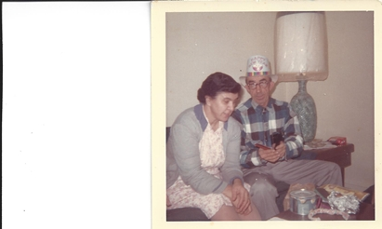

Slide 9
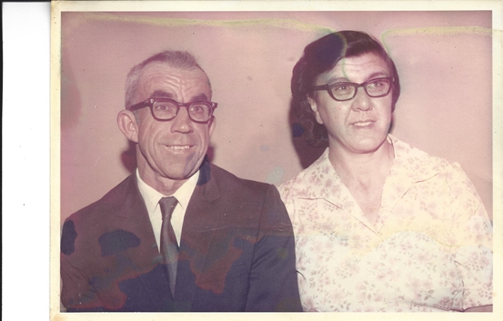

Slide 10
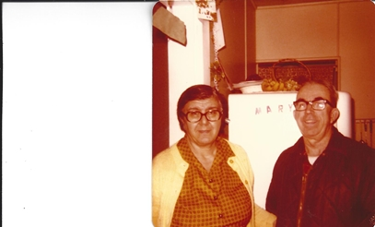

Slide 11
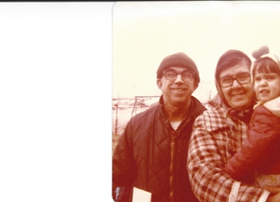

Slide 12
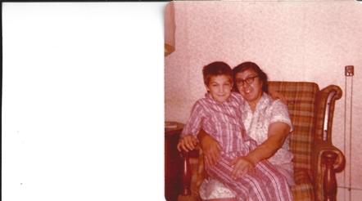

Slide 13
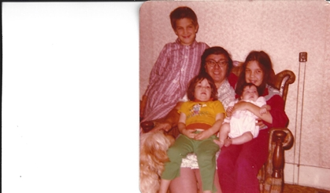

Slide 14
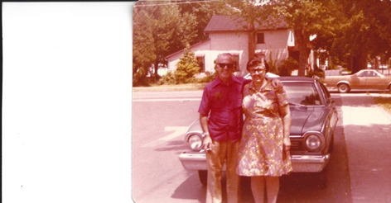

Slide 15
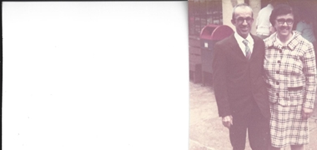

Slide 16
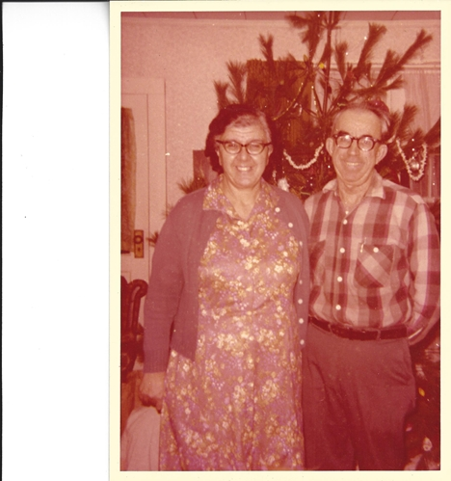

Slide 17
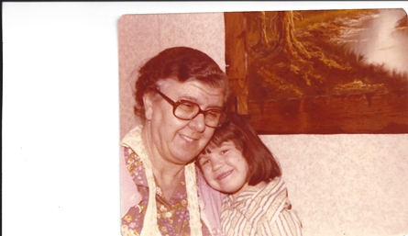
Grandma & Deb

Slide 18
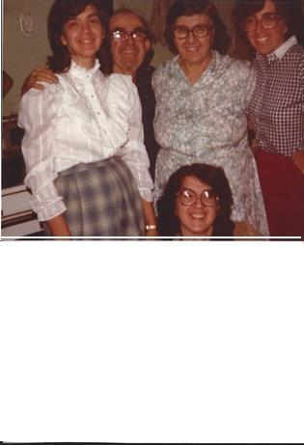

Slide 19
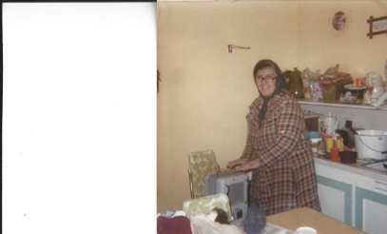

Slide 20
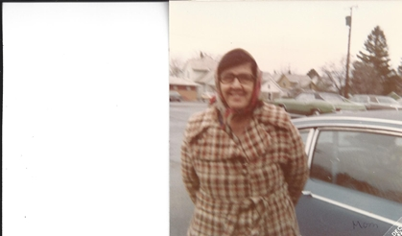

Slide 21
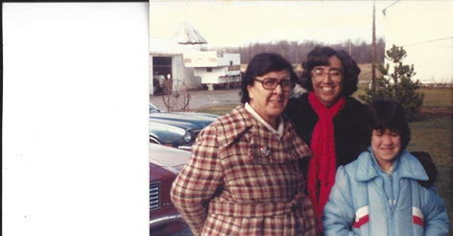

Slide 22
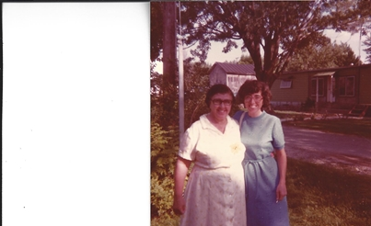

Slide 23
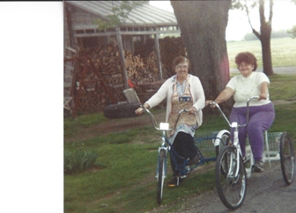

Slide 24
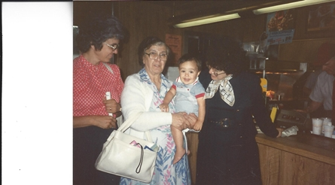

Slide 25
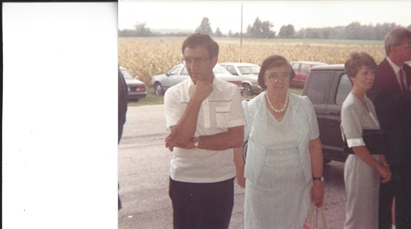

Slide 26
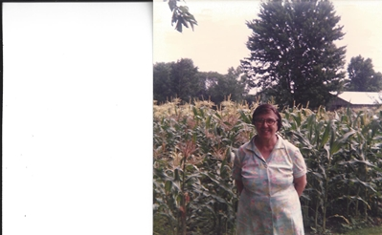

Slide 27
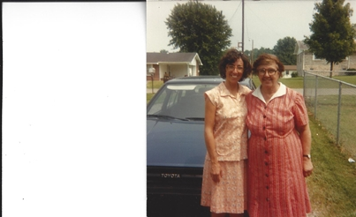

Slide 28
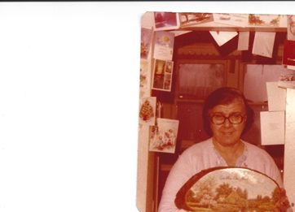

Slide 29
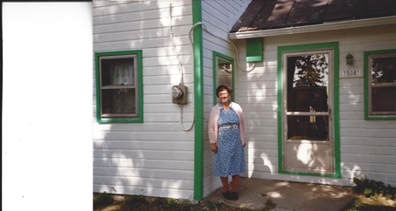

Slide 30
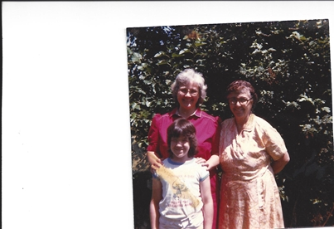

Slide 31
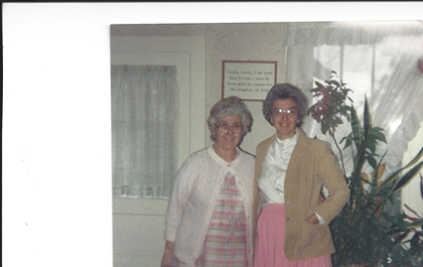
Mary & Mom

Slide 32
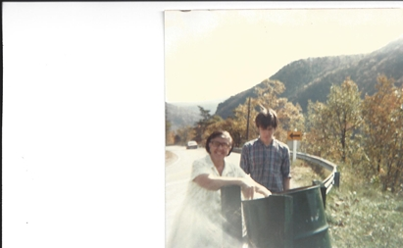
Grandma & Art 1984

Slide 33
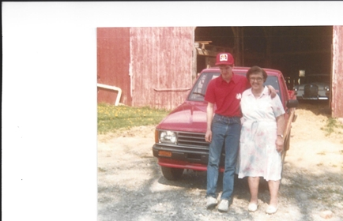
Grandma & Art 1989

Slide 34
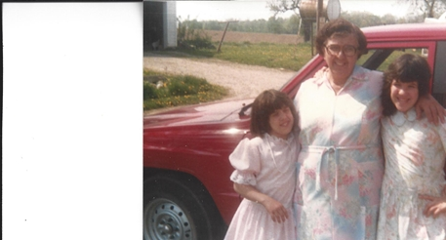

Slide 35
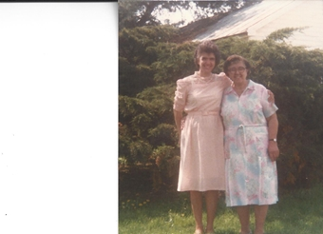

Slide 36
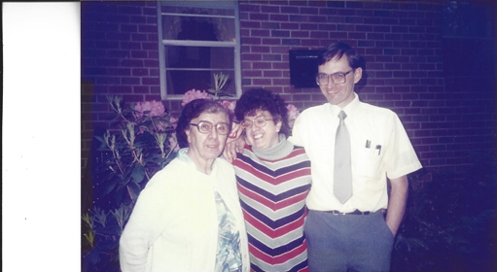

Slide 37
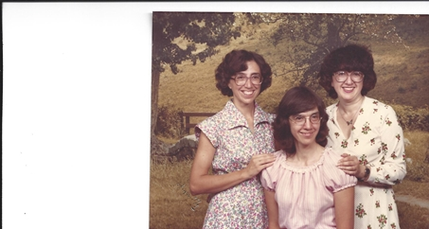

Slide 38
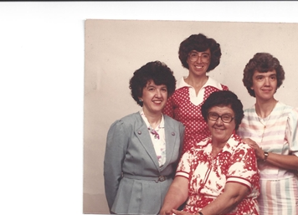

Slide 39
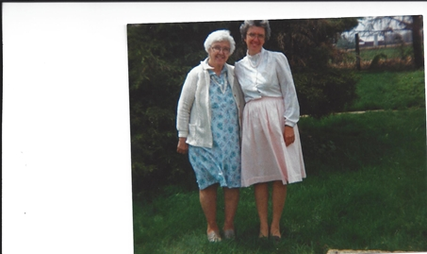

Slide 40
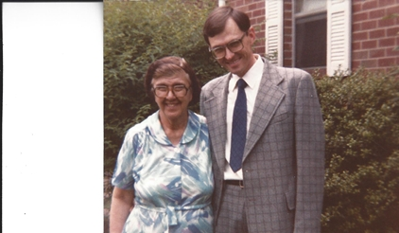

Slide 41
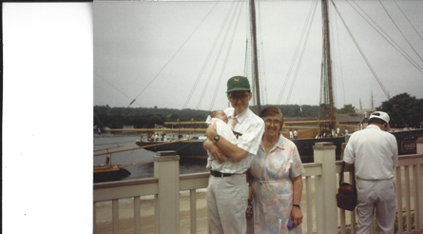

Slide 42
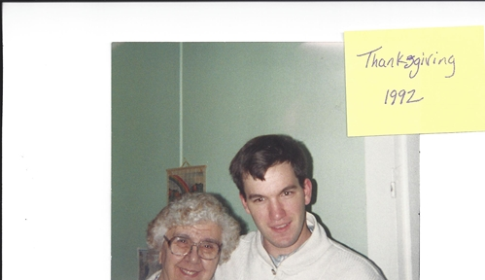

Slide 43
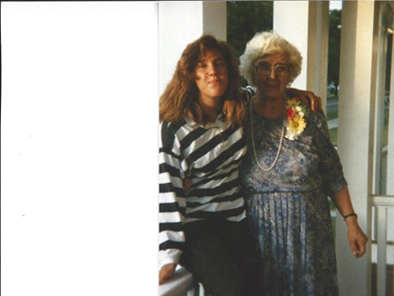

Slide 44
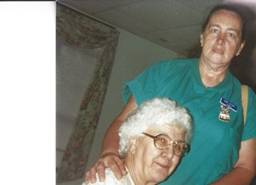

Slide 45
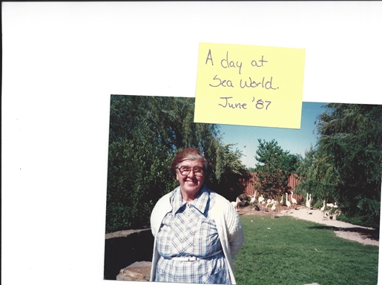

Slide 46
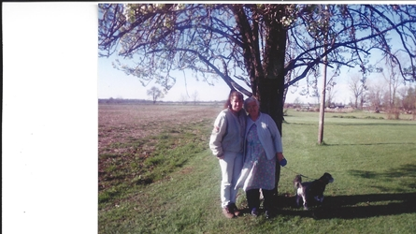

Slide 47
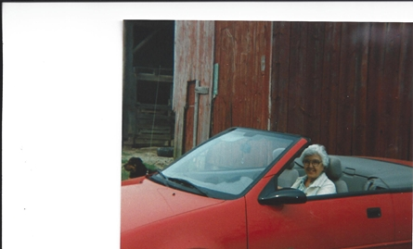

Slide 48
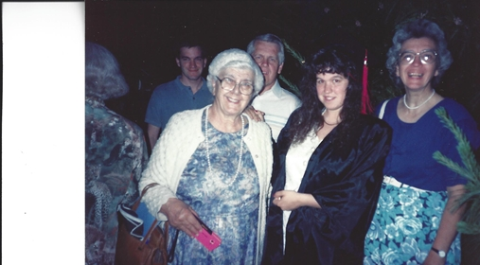

Slide 49
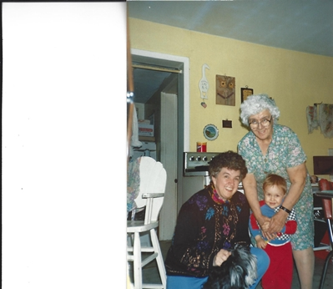

Slide 50
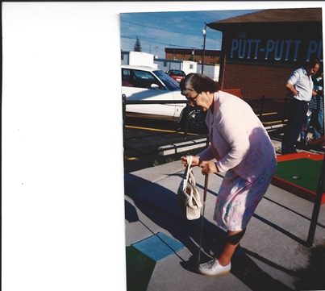

Slide 51
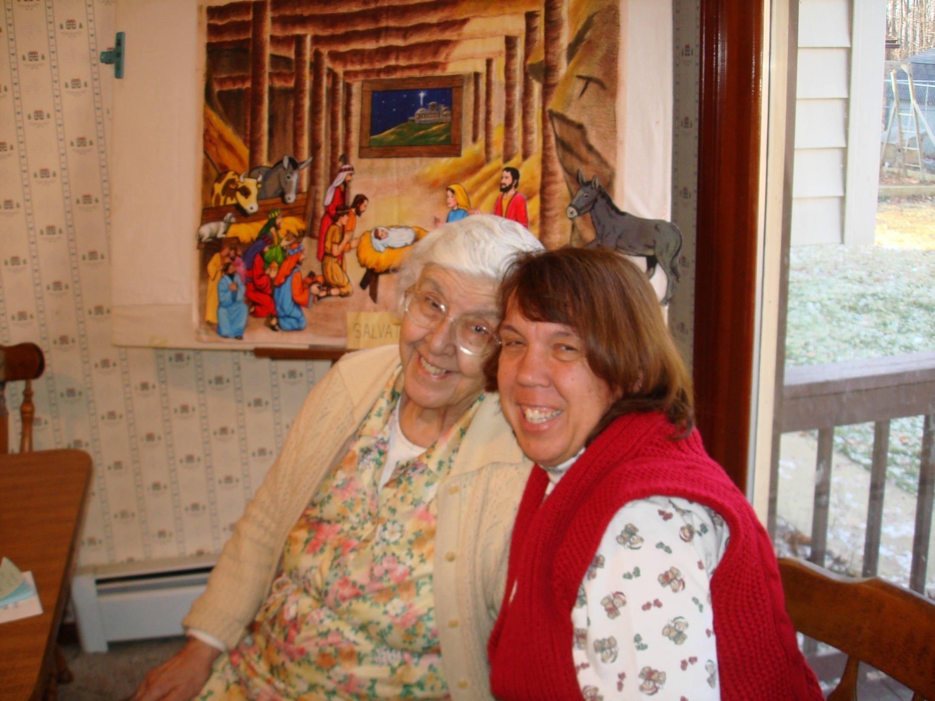

Slide 52

Grandma, Kathy & Lil Joe

Slide 53


Slide 54


Slide 55


Slide 56


Slide 57


Slide 58


Slide 59


Slide 60


Slide 61


Slide 62


Slide 63


Slide 64


Slide 65


Slide 66


Slide 67


Slide 68


Slide 69


Slide 70


Slide 71


Slide 72


Slide 73


Slide 74


Slide 75


Slide 76


Slide 77


Slide 78


Slide 79

Grandma & Darien

Slide 80


Slide 81


Slide 82

Grandma & Baby John 2001

Slide 83


Slide 84

Darien & Grandma

Slide 85


Slide 86


Slide 87


Slide 88


Slide 89


Slide 90


Slide 91


Slide 92


Slide 93


Slide 94


Slide 95


Slide 96


Slide 97


Slide 98


Slide 99


Slide 100


Slide 101


Slide 102

Grandma & Joseph

Slide 103


Slide 104


Slide 105


Slide 106


Slide 107


Slide 108


Slide 109


Slide 110


Slide 111


Slide 112


Slide 113

Grandma, Deb & Eric 2010

Slide 114


Slide 115


Slide 116


Slide 117


Slide 118

88th Birthday Party!!

Slide 119

Eileen & Mary visiting 2011

Slide 120

Christmas, Dec 2012

Slide 121


Slide 122

Jan 2013

Slide 123


Slide 124


Slide 125

Great Grandma & Baby Nathan

Slide 126

Easter 2013

Slide 127


Slide 128

Grandma, Darien, John & Nate

Slide 129

Easter 2013

Slide 130


